Slide 1

Academic writing PROC308 (Level 6)
Dr Jason Truscott
Learning Development
www.plymouth.ac.uk/learn

Slide 2
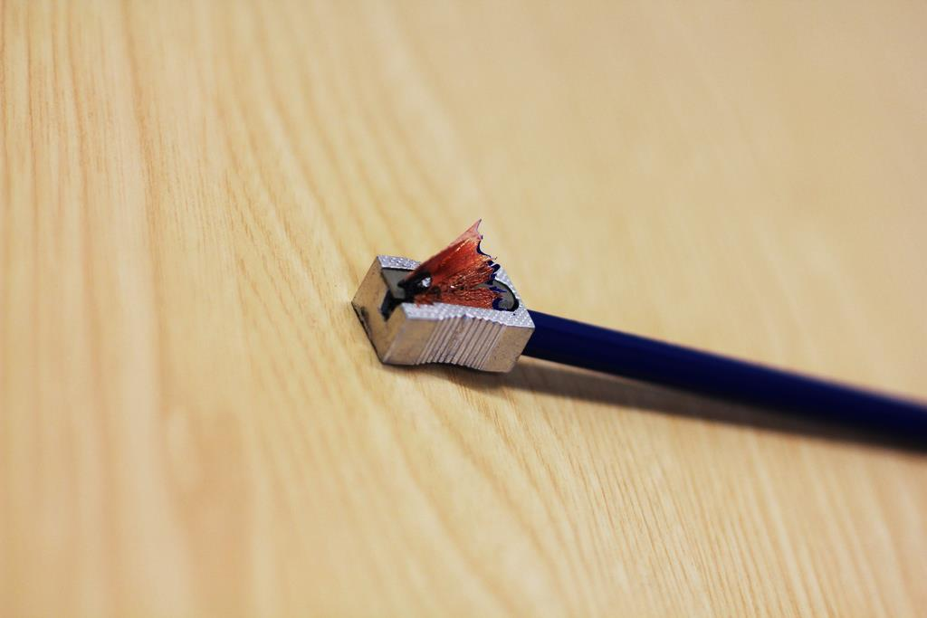

Learning Development can help with:
writing and presenting
developing thinking
using literature critically
managing projects
articulating knowledge
communicating ideas
preparing for exams and assessment

Slide 3



The Writing Café
Drop in (no booking!)
4th floor of Babbage 1pm – 4pm Mon-Fri (Semester time)
Coffee, tea and food!
www.plymouth.ac.uk/learn
Notes:
Just turn up with some writing and ask for feedback on a few pages!

Slide 4

English Language Centre ’English as a second language’
Writing Café
Mondays & Fridays (Only)
10am to 12 Noon
Help with grammar
https://www.plymouth.ac.uk/student-life/services/international-students/english-language-centre

Slide 5
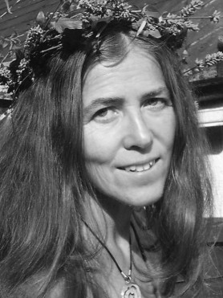
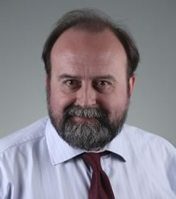
Royal Literary Fund Writing Fellow (writing tutorials)
How to structure an essay
How to make your writing clearer
How to write a good introduction or conclusion
Help with dissertations
Help with writing a PhD
and anything else directly related to academic writing.
Individuals only
Katherine Roberts
30th book,
‘The Ethical Leader’
Morgan Witzel
www.plymouth.ac.uk/learn
Notes:
Specifically about writing. Fellows will only see individuals (no groups!), can be used by students and staff alike.

Slide 6

Open Hours
with Jason
Business, Science and Engineering
Study skills advice
Drop in for a chat
Writing Cafe
Thursdays
10am to 12 Noon
www.plymouth.ac.uk/learn

Slide 7




Further details here:
www.plymouth.ac.uk/learn
Notes:
Individual and group tutorials: 01752 587676 or go to the Learning Gateway in RLB
Writing Café: 4th floor of Babbage
writing support 12 – 4 pm, Mon - Fri
Info: www.plymouth.ac.uk/learn
online study guides and links
Email: learn@plymouth.ac.uk
study related questions and advice

Slide 8

Challenges
What do YOU think are the most important elements of report writing?
3 minutes free writing
Notes:
TASK for students (students already writing their essay): What challenges have you anticipated for your literature review / essay? Discussion on what they might be…Collect a mind map.
E.g. how to organise things, how to reference, how to be critical. Hopefully this workshop will help you overcome these concerns, we will be covering most here. And we also have guides to refer to later. The point of today is to demonstrate that if you can write critically, you can write academically!

Slide 9

A closer look at academic writing

Slide 10
What is the most important aspect of academic writing (and practice)?

Slide 11
Critical thinking
This is the foundation of academic writing. Critical thinking can be linked to practice.
Description
What?
Analysis
Why?
Evaluation
So what?
Who?
When?
Where?
How?
What if?
What next?
Notes:
Critical thinking, and making points in your writing.

Slide 12
Thinking critically
Description
Analysis
Where?
Why?
Point ‘X’
Who?
Topic
How?
When?
What if?
What?
What next?
So what?
Evaluation
Notes:
This same process that a script writer would use to create a fully rounded story is EXACTLY what you need to use when reviewing your topic.

Slide 13
In terms of writing an essay, which is better?
Discussion
Conclusions
A
Point 2
Point 3
Introduction
Point 1
Point 3
Point 7
B
Point 1
Point 5
Conclusions
Point 2
Point 6
Introduction
Point 4
Notes:
The straight line is keeping flow of writing in the intended direction and appropriately so others can understand!. We will assume your introduction is 10-15% and Conclusions 10% of your writing!
A is the best approach, your reader can follow the flow of your writing. You have made 3 valid points that answers your brief (and you would have had space to apply full critical thinking). Description, analysis and evaluation. Analysis and evaluation are most important in your writing!! Especially in your 2nd year!
B gets there eventually, but the points are not well connected. Your ideas are roaming around. Plus can you really be critical with more points? Certainly if your essay word count is small. You are likely to only be descriptive in most circumstances

Slide 14
For a 3000 word essay, which is better?
Discussion
Conclusions
A
Point 2
Point 3
Introduction
Point 1
Point 5
Point 7
Point 1
Point 3
B
Point 6
Conclusions
Point 2
Point 4
Introduction
Notes:
Again the correct answer is A. You don’t actually have much space to really apply critical thinking if you have 7 points in a 3500 word essay. However, with 3 perhaps 4 at a push, you could at least apply some critical thinking. Description, analysis and evaluation.
At level 6 your tutor is looking for more focus.

Slide 15
Why those many points?
For example, a 3000 word essay:
Introduction is 10-15% (450 words)
Conclusions around 10% (300 words)
Discussion ~75% max (2250 words)
How many points in 2250 words?
Level 6 about 800 words per point
2250 / 800 = 2.8 (Approx. 3 main points)
Masters about 1000 words per point
2250 / 1000 = 2.3 (Approx. 2 main points)
Notes:
In the third year you are looking at 800 words for each main point!
Masters this goes up to around 1000 words!
Always look a the break down in the brief, sometimes less words are needed for the introduction etc!

Slide 16
Typical academic writing
Each point in the discussion has:
Critical thinking
Points move logically
Discussion
Conclusions
Point 2
Point 3
Introduction
Point 1
Notes:
The important part to remember is that each point includes critical thinking (Describe, Analyse, Evaluate) you may compare and contrast with other ideas or you may argue that a new approach is required.

Slide 17
Title: A typical example of academic writing
Introduction
First sentence relates to title and has a ‘hook’ to keep reader interested.
Background
Say what points will be discussed.
Predominantly future tense. E.g. ‘The following will be discussed…’
Discussion
Discuss those points in the same order…
Point 1 – Describe, analyse & evaluate.
Point 2 – Describe, analyse & evaluate.
Cont. – Describe, analyse & evaluate.
Ensure logical flow of ideas
Conclusions
Are a summary of the evaluations!
Don’t add anything new.
Write mainly in past tense. E.g. ‘It was found’.
Notes:
I appreciate that layouts will vary, and if you are doing a research proposal or literature review there were be different sub heading. Use the critical thinking model
However, the important elements to grasp are what is needed in order to write academically.
You need to set the scene, and say what will be discussed – any introduction needs this.
You then ensure that the points you said would be discussed are discussed with critical thinking. In the 3rd year you will be focusing more on the analysis and evaluation, that is what will yield the most marks!
The conclusions are a summary of those evaluations you made in the discussion. So if you did your critical thinking properly, you already have the basis for your conclusions!
Of course you should also include a reference section, and use references to support your arguments.

Slide 18
Deconstructing report writing
Academic/report writing is writing…
…With a few additional rules
Notes:
Who has written a play, a poem, an email?
Then you already know about writing.
The skills you need for writing your essay are not far off from writing a script or visual story.

Slide 19
Differences between reports and essays
Reports are: | Essays are:
Formally structured Informative and fact-based Written with a specific purpose and reader in mind Written in a style appropriate to each section Always include section headings Sometimes use bullet points Often include tables or graphs Offer recommendations for action | Semi-structured Argumentative and idea-based Not written with a specific reader in mind Written in single narrative style throughout Usually do not include sub-headings Usually do not include bullet points Rarely include tables or graphs Offer conclusions about a question
Learnhigher (2012) What’s The Different Between Reports And Essays? http://www.learnhigher.ac.uk/writing-for-university/report-writing/whats-the-different-between-reports-and-essays/ (Accessed: 08/02/2018)

Slide 20
Third person or First Person
Are you familiar?
Notes:
Avoid the used of first person such as ‘I’ and ‘me’…
Rather than ‘I found the following…’ in third person you would writing: ‘The following was found…’

Slide 21
What is required for the assignment?
Project handbook!

Slide 22
Understanding the brief or creating a title
Analyse two key areas of …computing and critically evaluate the impact it has on …
T.A.P. model: Topics, Actions, Parameters
Additional parameters:
What else do you need? …Word count, font size, use of table and figures, preferred reference style? Etc …Look at your Project Handbook and marking benchmark!
N.B. The project handbook has report styling requirements
Notes:
1) Before we get onto those rules for academic writing, lets just look at how you would start to prepare your topic.
Consider the TAP model in breaking down this process:
T is for Topics – the central or key theme
A is Actions – what you need to do
P is Parameters – what limitations
The TAP model is described in more detail in our guide on Writing essays: www.plymouth.ac.uk/learn
Once you have understood your brief, you can start reviewing your materials - This is the part that takes the most work but will lead to the greatest rewards.
It does not really matter what your material is, it could be a series of documents or sources on the topic you have been given. Or it could be a specific resource that you have been asked to review. The important thing is to start capturing your ideas about the source or sources.
Consider how you will incorporate this into your word count 1500 words – short essays would mean limiting your focus on specifics. Larger bodies of writing allow you to explore other related ideas.

Slide 23
Good presentation (title page)
My computing project title
J. Bloggs
May 2018
Plym Uni
My computing project title
A report submitted for…..
J. Bloggs
Student no. xxxxxxxxxx
School of Computing,
Electronics & Mathematics
University of Plymouth
May 2019
Examples only
Bad presentation and formatting!
‘cannot be bothered’ first impression
Better!
N.B. often a student number is required in place of a name for certain work, so always check!

Slide 24
N.B. Check your brief and
examples, as numbering
the sections are not always
required.
Title page: Typical scientific/technical report
Summary (Abstract)
Acknowledgments - thanks or recognition
Table of contents
Introduction (Sets scene: project aims, objectives and background)
Main body
2.1 Discussions about 1st topic:
Describe, analyse and evaluate
2.2 Discussions about 2nd topic: Describe, analyse and evaluate
2.3 Discussions etc…..
Conclusions
Are a summary of the evaluations
Recommendations
Can also be drawn from evaluations
References (sources that are used in the main text)
Bibliography (Sources read but not used in text)
Appendix/Appendices
Often placed before the
recommendations

Slide 25
Report writing (numbered)
Tend to be a numbered format:
1.0 Introduction
1.1 …
1.2 …
2.0 Main Body (contain topics of discussion)
2.1 Subsection to 2.0
2.1.1 Subsection to 2.1
3.0 Main body topic 2
4.0 Main body topic 3
5.0 Conclusions
6.0 Recommendations (not always needed)
References
Appendices
This is a simplified example – check your brief! (Project handbook is written like a report)
Notes:
The headings provided here are examples, this varies and depends on the brief or student handbook!

Slide 26
What should I write?
1.0 Introduction
1.1 - What you will discuss, and why
2.0 Main body topic (Point): Describe, analyse & evaluate
Mention points in order (as per introduction) Use critical thinking!
3.0 Main body topic (Point): Describe, analyse & evaluate
3.1 – New topic (Point): Describe, analyse & evaluate
However, these sections MUST include some discussion, not just bare facts.
This is a simplified example – check your brief! (Project handbook is written like a report)
Notes:
Introductions - in reports are typically a little shorter than essays around 10% (but do check with your tutors or student handbook)
Discussions - contain the bulk of the text and definitely need critical thinking.
Conclusions – This is a summary of your evaluations!
Recommendations – what do you recommend?

Slide 27
What should I write?
3.0 Conclusions
3.1 These are a summary of the evaluations from discussion that are not recommendations
3.1.1 - DO NOT add anything new…
This is a simplified example – check your brief! (Project handbook is written like a report)
Notes:
Introductions - in reports are typically a little shorter than essays around 10% (but do check with your tutors or student handbook)
Discussions - contain the bulk of the text and definitely need critical thinking.
Conclusions – This is a summary of your evaluations!
Recommendations – what do you recommend?

Slide 28
Main body (DO NOTs)
Should NOT normally include
Lists of raw results
Minute details of hardware
Complete listings of software
Repeated calculations of the same kind

Slide 29
Table of contents
Summary………………………………………………i
Acknowledgments……………………………….ii
1. Introduction………………………………………1
1.1 xxxxxxxx……………………………………….1
2. Main body..……………………………………….3
2.1 xxxxxxxx.……………………………………..4
2.1.2 xxxxxxxxxx……………………………5
And so on….
Did you know (I expect you did…): if you use the MS Word style sheet for headings, you can automatically create a table of contents!

Slide 30
Academic writing / Critical writing
Description
What?
Analysis
Why?
Evaluation
So what?
Who?
When?
Where?
How?
What if?
What next?
Notes:
Ok you have ideas, but you need to start turning them into writing. You will remember that I made the point earlier that academic writing was just writing with a set of rules on top. Well, now it’s the time to prove my point to you!
Those rule involve using a process called ‘critical thinking’, and this can be achieved by asking a series of questions of the material or the sources that we are evaluating. This consists of 3 processes:
Description is the most common one and we are all used to it, it tells us the basic facts about the topic or the problem we are discussing.
Analysis introduces the first level of critical thinking, we start to ask questions about what was described.
Evaluation is the final level that enables us to draw conclusions and make recommendations for additional work or ideas.
Most people get the first part, it is quite easy to describe things, but the last parts have to be learned in order to master critical thinking and academic writing.
So why are Analysis and Evaluation important in academic writing? They are actually important in many types of writing, including story telling.
Why? Now we are going to look at this from a different angle. How many of you here have watched murder mystery or crime fiction?

Slide 31
Imagine you are a Hollywood director…
…and handed some scripts to read.
The film brief: a murder mystery about an important person murdered in a public place, at night.

Slide 32
Script 1
Stabbed to death
In the library
Last night
Professor Plum
THE END
Notes:
You are all Hollywood producers who are reviewing scripts for a crime drama – There has been a murder –
Description – What? When? Who? Where? Professor Plumb was stabbed to death in the library, last night with a knife.
The End
Is this a good script?
No, because it only describes the situation.

Slide 33
Script 2
Description
Stabbed to death
In the library
Last night
Professor Plum
Detective involved
Pathologist report
2 Suspects & 2 motives
Scenarios
THE END
Notes:
Analysis – Why? How? What if? Why was he killed? There are two suspects that had motives. How was he killed? Did he actually die of stab wounds? What if it was something else? What if the knife was just for show? Suspects – Miss Scarlett and Colonel Mustard
The End - Is this a good script?
A bit better, but you don’t actually know what happens in the end?...
Note the first part is the description…

Slide 34
Script 3
Description
Stabbed to death
In the library
Last night
Professor Plum
Detective involved
Pathologist report
Suspects & motives
Scenarios
Analysis
Evaluation
Chief Inspector
Identified evidence to murder
Suspect charged with murder
Court + Justice
THE END
Notes:
Evaluation –
Chief Inspector > Evaluation
Identified evidence to murder > So What?
Suspect charged with murder > What next?
Court and justice > full evaluation
The End - Good script? Yes?
YES! This give the whole film context, start, middle and conclusion. Note that this flow from Description – analysis – evaluation is exactly what you need to do in your academic writing!!!

Slide 35
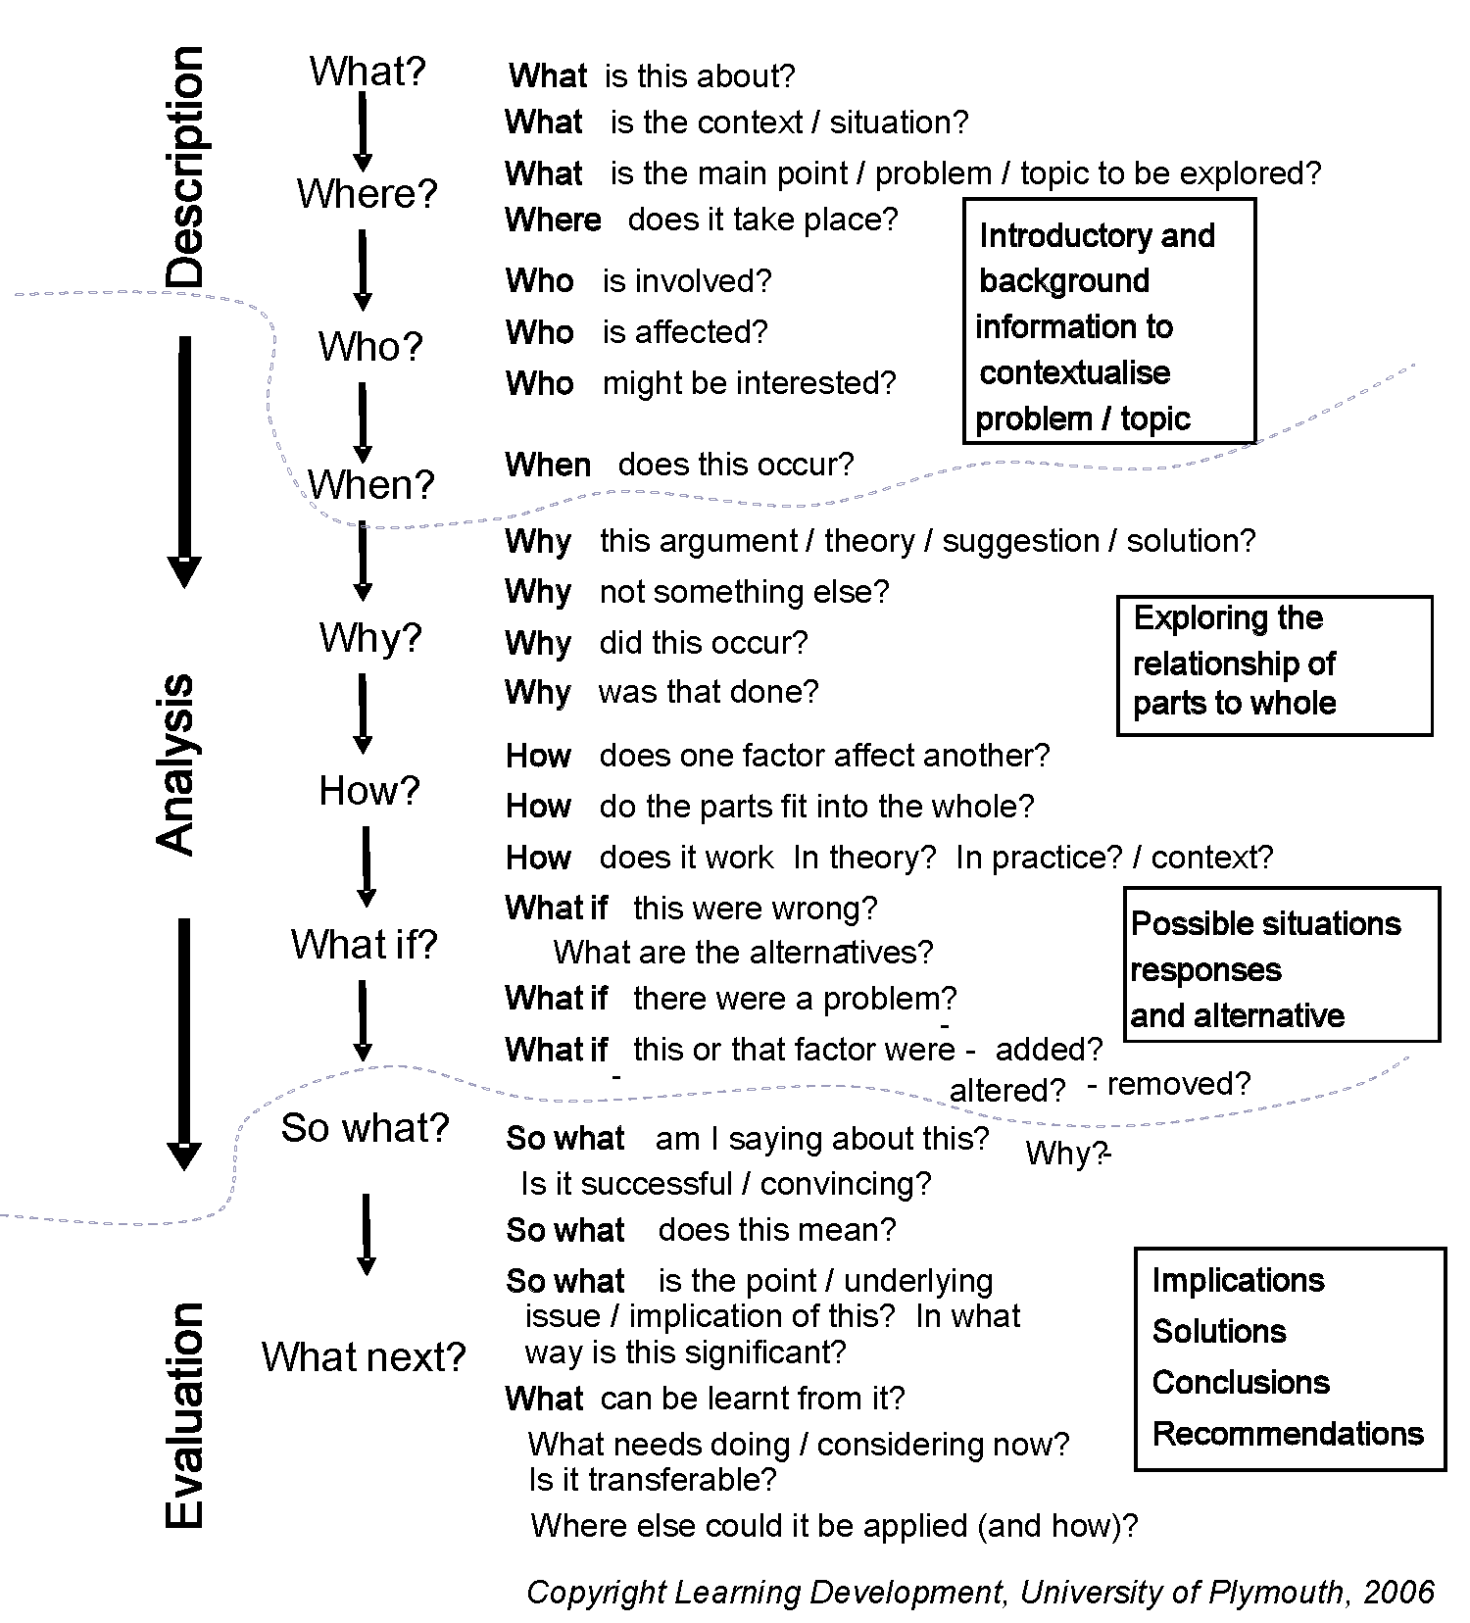
Notes:
This is a much more detailed example. Remember you don’t have to include every single one, as it might not be appropriate in your essay. Just be sure to include those that are relevant!
Also look at the details in the boxes in the slide, they have useful contextualised insights.
This is available on the Learning Development website in our guide on ‘Critical Thinking’ and also the ‘Model to generating critical Thinking’. Link (guides at bottom of the page): www.plymouth.ac.uk/learn

Slide 36
Discussion?
Is this a good discussion?
Forsyth (2013, p.36) states that ’…others in the field of computing should do the following…’ There are also a number of suggestions that computing practice should be… (Jones, 2016). Jones (2016) also describes this initial process as having…and there are a number of things to consider… According to Harvey (2015) it is required that computing specialists carryout… The guidelines also details certain aspect of practice required… (Fredrick, 2016). Jones (2016) touches on this by demonstrating…
NO! This is sentence after sentence of facts (only description)…
However, it is a good use of Harvard (‘in-text’ citations) referencing.
Notes:
While this is referenced correctly for a Harvard format, this is literally just a wall of detail…. Descriptive facts which will lead to poorer marks.

Slide 37
Sentence flow
‘Leaving aside the issue of structured training, normal daily physical activity is a neglected area. Daily exercise can…’
(Godfrey, 2013: 36)
Godfrey, J. (2013) The Student Phrase Book: Vocabulary for Writing at University. Palgrave Macmillan.

Slide 38
Paragraphs
Typically 5-7 sentences in length
Help break up the text
Makes it easier to read
Only use as a rough guide
The first sentence of the paragraph most important!
Helps with the flow

Slide 39
Making paragraphs flow
The first sentence should help the reader understand the direction of writing:
Continuation from the last paragraph
Or starting a new point
‘The previous paragraph outlined the main sources of automatic ageism. There are also several other more minor sources.’
(Godfrey, 2013: 36)
Godfrey, J. (2013) The Student Phrase Book: Vocabulary for Writing at University. Palgrave Macmillan.

Slide 40
Critical thinking
Discussion
Conclusions
Point 3
Point 4
Introduction
Point 1
Point 2
Critical thinking
Describe
Analyse
Evaluate
Notes:
The important part to remember is that each point includes critical thinking (Describe, Analyse, Evaluate) you may compare and contrast with other ideas or you may argue that a new approach is required.

Slide 41
Describe, Analyse and Evaluate
Looking at individual design stages for any computing project, …it is particularly important… (Harvey, 2016). Good computing practice should always… (Matthews, 2015). Certainly Frederick (2016) demonstrates many approaches to help avoid potential failures with certain computational designs…
However, to gain a better understanding of where poor design can lead to project failure, it is important to examine… …certainly I.T. specialists need to communicate clearly what… as also suggest by Adams (2006). Although, one major drawback of this approach is that… (Harvey, 2016). In order to ensure that any design is…and performs as intended…, a new approach is required to overcome those issues… However, Brian (2016) provides a solution that would lead to better…
Having considered all the important issues associated with computational design practices, there is clear evidence that more needs to be done…, particularly… Making these changes would not only improve practice, but also lead to further improvements in...resulting in fewer failures… It is therefore recommended that…
PLEASE NOTE: make sure the acronyms are explained
E.g. Information Technology (I.T.) - appreciate this one is obvious, however, doing so ensures absolute clarity!
Notes:
This is a typical approach to critical thinking. Note that the description (before the first ‘however’) is very short. Description is literally just saying ‘What?’ is the main point about, keeping it short, then moving onto the analysis.
Analysis can start with words like ‘However’ (Why? Or How? Questions). Ultimately ensure that you use words that show you are analysing, not just adding more facts. You may find the Manchester Phrase Bank helpful in this respect: http://www.phrasebank.manchester.ac.uk/being-critical/ When on this website, please note the left hand menu for other phrases.
Finally, the icing on the cake, evaluate. ‘Having considered…’ (So What? Or What Next?) at this point you pull together the analysis, thus demonstrating to your tutor the intended direction or decision. This part may seem obvious, but if left out, you are not going to achieve better marks.
Note: Ensure that you reference new ideas or facts throughout. Sometimes this is also extended into the evaluation section, but be careful that it does not sounds like more analysis. References here can help reinforce a decision for a specific course of action base on the original analysis.

Slide 42
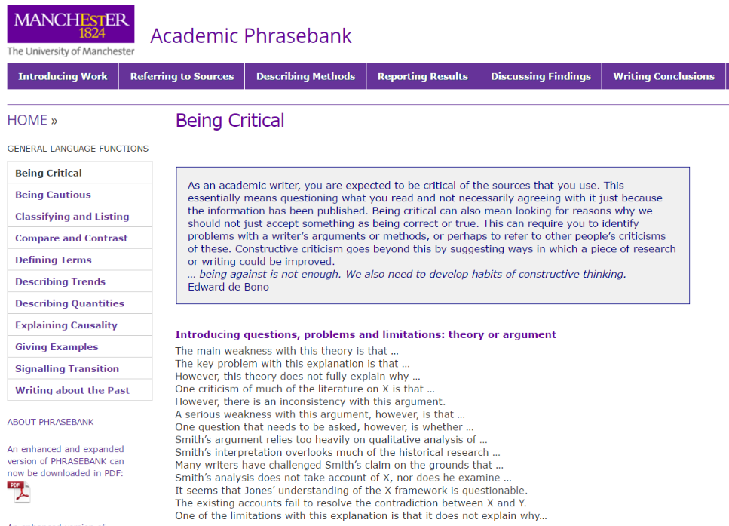
Writing with critical language
www.phrasebank.manchester.ac.uk
Manchester Phrase Bank
Note the left navigation menu:
Being Critical
Being Cautious
Classifying and Listing
Compare and Contrast
Defining Terms
Etc…
Notes:
The use of ‘however’ or ‘although’ are good words to demonstrate critical writing (analytical). However, there are times when you want use something different. In this respect the phrase bank is very good to help you construct your sentences to ensure you are sounding critical, or comparing and contrasting or being cautious about your critical views of the literature. You all have your own writing style, so some of these phrases may not be your preference. Pick and choose what you feel works for you.

Slide 43
Other examples
Other example reports (N.B. some provided on module DLE)
What about journal articles? E.g.
Analyzing the ecosystem of malicious URL redirection through longitudinal observation from honeypots
https://www.sciencedirect.com/science/article/pii/S016740481730007X
Structures can vary (headings and sub-headings)
Can provide ideas for structure approach

Slide 44
Making an argument?
Everyone clear on this?

Slide 45
Developing arguments
4. Implications
1. Controlling statement First sentence ‘controls’ the rest of the paragraph
State significance and link to next paragraph
3. Support
2. Justification
Theory and references: Evidence Case study Analysis
Unpack the controlling statement: Explain Analyse
Notes:
This is all about setting the scene for the argument – justifying your claims with supporting evidence. A claim is nothing without evidence to substantiate.
Don’t forget to explain the significance of those implications!

Slide 46
How to reference
Cite Them Right (book and also online) http://www.citethemrightonline.com.plymouth.idm.oclc.org/
Off campus
This link includes university authentication (bookmark for future reference)
Always check your assignment brief for preferred referencing format. The following example is the commonly used ‘Harvard’ format.
Notes:
References/arguments/discussions/opinions are liken to actors bringing their own views.
Don’t forget that you need to give credit to those ideas!

Slide 47
How to reference a book (example)
Be consistent with references and in text citations (Harvard):
In text citations:
(Johns, 2013, p. 25) or Johns (2013, p. 25)
Reference:
Johns, J.B. (2013) A guide to good computing practice. London: A publisher.
Notes:
References/arguments/discussions/opinions are liken to actors bringing their own views.
Don’t forget that you need to give credit to those ideas!

Slide 48
How to reference (journals)
More than three authors (Harvard):
In text citation:
(Jacobson et al., 2014) or Jacobson et al. (2014)
Reference:
Jacobson, R.J., Harrison, T., Ford, H., and Jones, P. (2014) ‘Hackers and Phishers: what really goes through their minds?', Journal of Information Technologies, 33(3), pp. 323–326.
Notes:
References/arguments/discussions/opinions are liken to actors bringing their own views.
Don’t forget that you need to give credit to those ideas!
The examples here are fake references…

Slide 49
Reference list (Harvard: alphabetical order)
References
Adams, B. (2013) Household router security, London: A publisher.
Hamill, L. (2011) Understanding the death of Flash. 3rd ed. Basingstoke: Palgrave.
Jacobson, R.J., Harrison, T., Ford, H., and Jones, P. (2014) ‘Hackers and Phishers: what really goes through their minds?', Journal of Information Technologies, 33(3), pp. 323–326.
Johns, J.B. (2013) A guide to computing practice, London: A publisher.
Vivoni, E.R. and Camilli, R. (2003) ‘Science and truth: are they really synonymous terms?’, Philosophy in science, 13(4), pp. 457-468.
Notes:
These references are all fake!
References/arguments/discussions/opinions are liken to actors bringing their own views.
Don’t forget that you need to give credit to those ideas!
The examples here are fake references…

Slide 50
Bibliography
This is different to a reference list
The bibliography items are things you might have read, but not cited (referenced) in the main report
Highlights ‘useful’ additional reading
Demonstrates wider reading

Slide 51
Appendices
Appendices are not typically included in the word count!
Items you might consider:
Requirements List
Concept sketches and photos of prototypes (not needed in main body)
Drawings and other illustrations not appropriate for the main body of the text
Concept evaluation tables
Project milestone tables
Meetings
Sample code
Anything that would make the main body difficult to read
However….DO NOT use the appendices as a dumping ground!

Slide 52
Think about why you are writing
Planning:
The aim of my essay/report is to…
My argument will be valuable because…
My main points are… (Check the brief)
My conclusion will be…
My recommendations will be…

Slide 53
Writing the first draft
Free writing maybe all you need to get started
Ensure you structure your writing appropriately
Decided on appropriate sub-heading or sections needed
Easier to establish the main structure earlier on
What is it that your tutor wants?
How can you achieve this?
Notes:
Ideas on how to approach your first draft, if you have already made a start on your assignment, then use these for future work.

Slide 54
Keep writing
Write regularly, 15-30 mins a day, to maintain momentum
Avoid over elaborate writing, be concise and to the point; being aware of linking phrases and flow
Proofread aloud and carefully to ensure proper language use and readability
Talk about your ideas and writing as much as you can with others
Read academic texts to see how they ‘sound’, follow the principles of their good practice

Slide 55
Report check list
What is the purpose of this report, and has it fulfilled that clearly?
Are your ideas presented logically?
Is there enough information, is the information included accurate?
Does the report cover all the key points?
Do you analyse your evidence/data?
Data & information → conclusions → recommendations?
Language, tone and style clear, direct and formal?
Is the grammar, punctuation and spelling correct?
Is the layout simple, clear, logical and consistent?
Clear, useful figures and tables, integrated and referenced?
Appropriate range of sources? Acknowledged properly?
Should there be a glossary? If there is one, is it comprehensive?
Are the appendices clearly labelled and signposted?
Have you left it for a while, gone back and reviewed it?
(adapted from Burns and Sinfield, 2008)

Slide 56

Feedback on this workshop
https://bit.ly/2xxq1gS
Enter in web browser
Or use your mobile scanner

Slide 57

Questions?

